Slide 1
Web Development
CSE343
Lab 4

Slide 2
Advanced JavaScript Features

Slide 3

ES6 Features – Shortcuts for Optimizing Code
ES6 (short for ECMAScript 6) is a major update to the JavaScript language, released in 2015.
Before ES6:
  Code was verbose (too many lines for simple tasks).
  There were no proper ways to write classes, modules, or constants.
  Asynchronous code (like waiting for network data) was hard to manage.
ES6 introduced many new features that made JavaScript cleaner, more consistent, and developer-friendly. Introduced modern syntax like:
  let/const (We saw in previous lab)
  arrow functions
  template literals
  destructuring, (New concepts to discuss today)
  spread/rest
  Classes
  Modules import and export

Slide 4
Recap Arrays and their Methods
Definition:
  An array is an ordered collection of values (elements) accessible by numeric indices starting at 0.
Characteristics (special for JavaScript):
  Can contain mixed types (numbers, strings, objects, functions).
  Length is dynamic and adjusts as elements are added/removed (arr.length).
Mutating Method(change original array): push, pop, shift, unshift, splice, sort, reverse.
  Ex: JS Snippet
  const mixed = [1, 'two', {name:'A'}, [3,4]];
  mixed.push("mango"); // [1, 'two', {name:'A'}, [3,4], "mango"]
Non-mutating Method(return new array/value): map, filter, reduce, slice, concat, flatMap.
  Ex: JS Snippet
  const nums = [1,2,3];
  const doubled = nums.map(n => n * 2); // [2,4,6]

Slide 5
Finding Elements in Arrays (Return one value)
Method | Description | Example
indexOf() | Find index of value | fruits.indexOf("banana");
includes() | Check existence | fruits.includes("apple");
find() | Find first element that matches | [3,7,10].find(n => n > 5); // 7
findIndex() | Get index of first match | [3,7,10].findIndex(n => n > 5); // 1
Transforming Arrays
Method | Description | Example
map() | Create new array by applying a function | [1,2,3].map(n => n * 2); // [2,4,6]
filter() | Return array elements that match condition | [1,2,3,4].filter(n => n % 2 === 0); // [2,4]
reduce() | Combine all elements into single value | [1,2,3,4].reduce((sum,n) => sum+n, 0); // 10

Slide 6
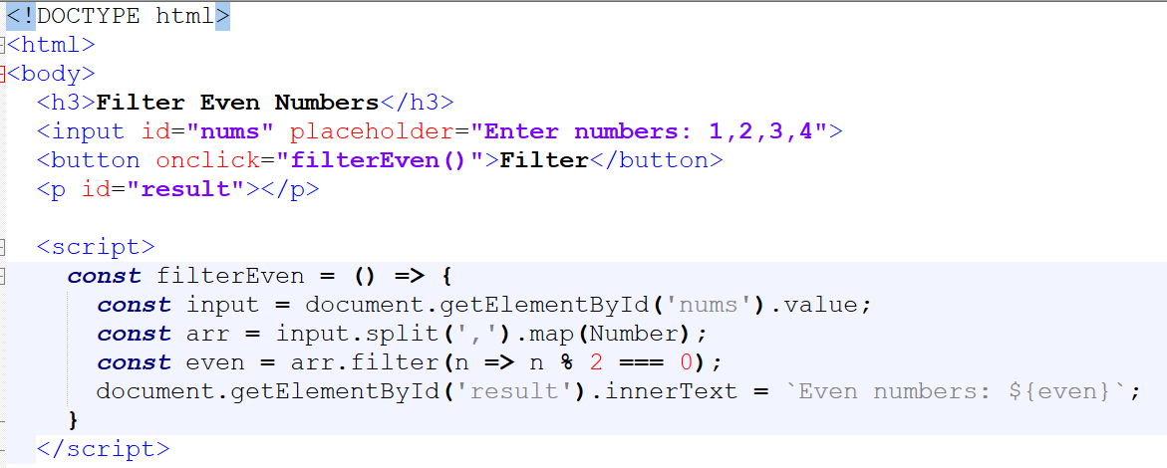

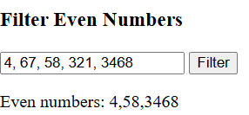
Example Code

Slide 7
Chaining Array Methods: Predict the Code Output
Chaining lets you express multi-step data pipelines concisely. Example:
const numbers = [1, 2, 3, 4, 5];
const evenSquares = numbers
.filter(n => n % 2 === 0)
.map(n => n ** 2)
.reduce((sum, n) => sum + n, 0);
console.log(evenSquares);
You can execute multiple array methods in sequence. Make sure to place the first operation first followed by others:
Main_array.1st_method.2nd_method. Etc…

Slide 8
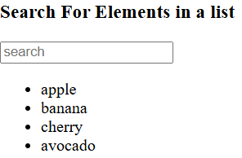
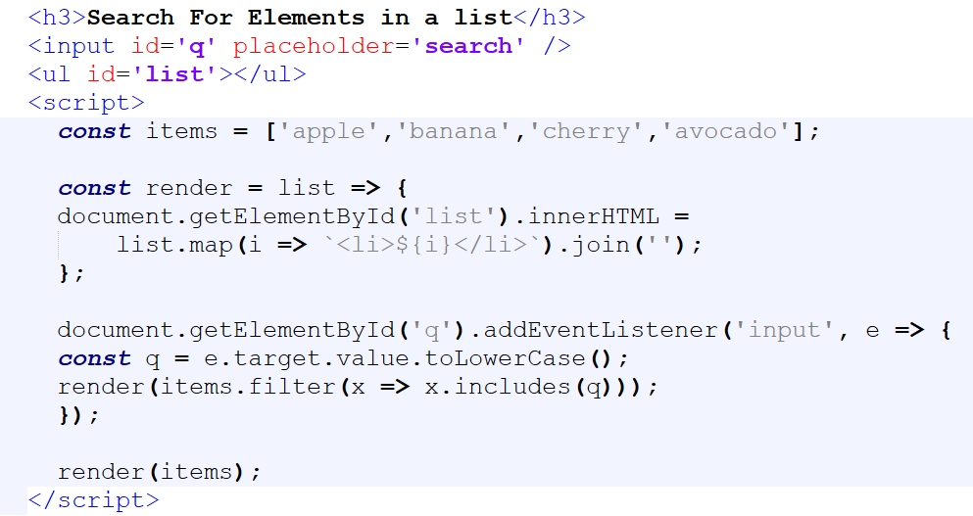
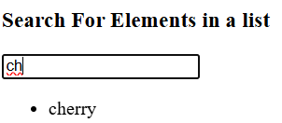
Example Code

Slide 9
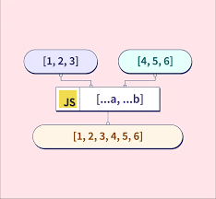
Spread and Rest Operator (…)
ES6 provides “Spread Operator” to expand elements of an array
Ex:
  const a = [0, 1, 2];
  const merged = [...a, 3, 4, 5]; //[0, 1, 2, 3, 4, 5]
Common use cases for the spread operator:
  Copying arrays: const copy = [...arr];
  Merging: const merged = [...a, ...b];
  Spreading into function calls: Math.max(...nums);
Rest Operator collects multiple arguments into an array.
Commonly used in function args:
  function sum(...numbers) {
  return numbers.reduce((a, b) => a + b);
  }
  console.log(sum(1,2,3)); // 6
Note: spread/rest use same token (...) but context decides meaning.

Slide 10
Array Destructuring
ES6 allows for extracting data from arrays based on the context of the new variables used to store the extracted data.
Examples:
  const [first, second] = ["apple", "banana", "cherry"];
  console.log(first); // apple
  const [head, ...tail] = [1,2,3,4];
  console.log(tail); // [2,3,4]
Array Utilities
Array.from(iterable): convert iterables or array-like objects (NodeList, arguments) to arrays.
  const str = "hello";
  const letters = Array.from(str); // ['h','e','l','l','o’]
Array.of(...): create array from arguments safely.
  const nodes = Array.from(document.querySelectorAll('li')).map(n => n.textContent);

Slide 11
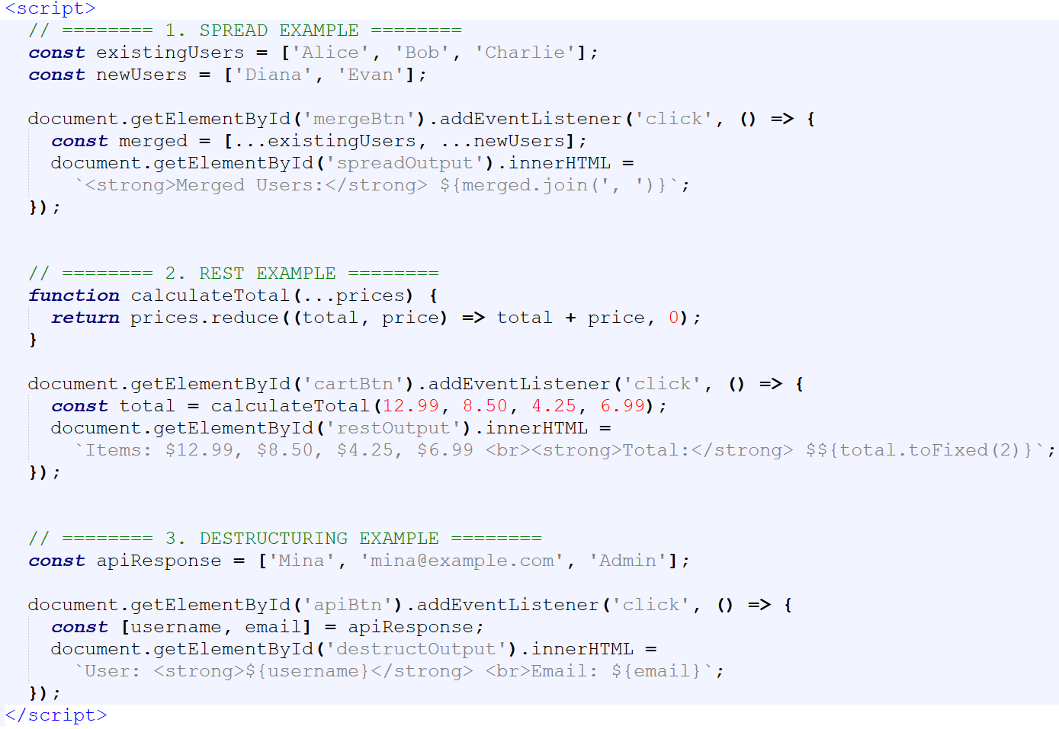



Example Code

Slide 12
Sets and Maps
Sets
Maps
A Map stores key-value pairs (like objects but more flexible).
Any type can be a key not only strings.
It remembers insertion order and is great for dynamic key-value storage.
Methods include:
  set(key, value) → adds/updates a pair.
  get(key) → retrieves value.
  has(key) → checks if key exists.
  delete(key) / clear().
  forEach(callback) → iterate entries.
A Set is a collection of unique values (no duplicates allowed).
It’s useful when you want to remove duplicates from an array or check membership quickly.
Set maintains insertion order.
Methods include:
  add(value) → adds a value.
  has(value) → checks existence.
  delete(value) → removes a value.
  size → number of items.
  forEach(callback) → iterate elements.
const names = ['Ali', 'Mona', 'Ali', 'Sara'];
const unique = new Set(names);
document.getElementById('output').textContent = [...unique].join(', ‘);
// "Ali, Mona, Sara“ (Notice why “...unique” is used not “unique”)
const users = new Map([["Ali", 20], ["Mona", 25]]);
users.forEach(
(age, name) => console.log(`${name} is ${age}`));

Slide 13
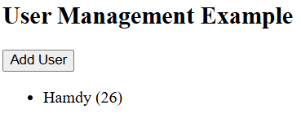
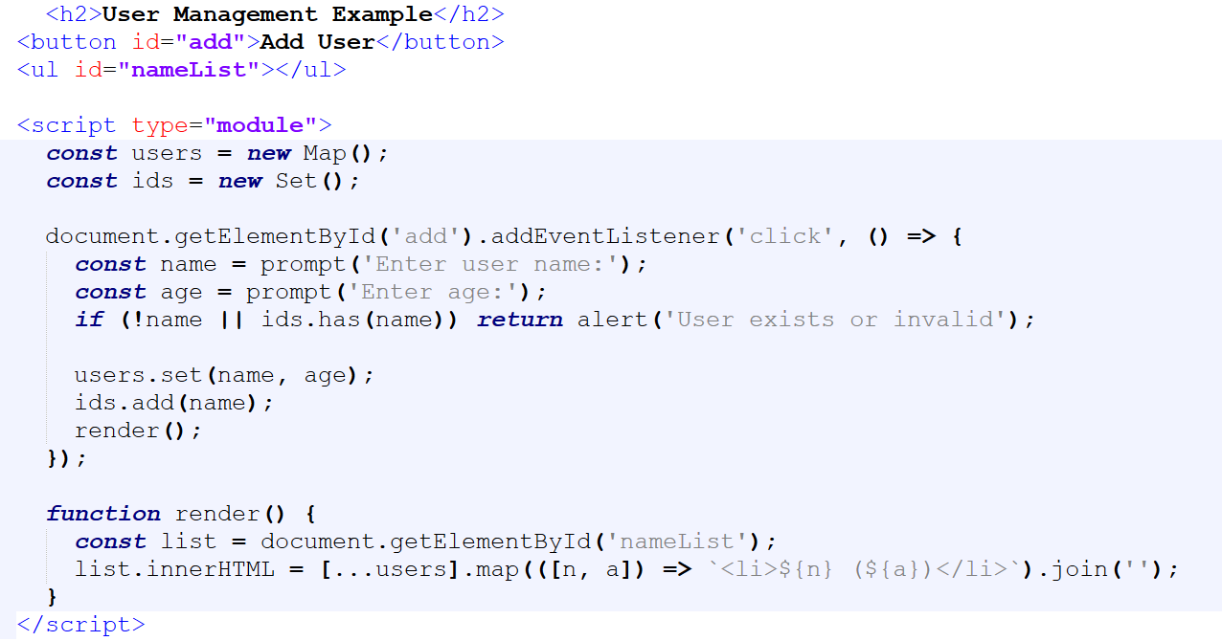
Example Code

Slide 14
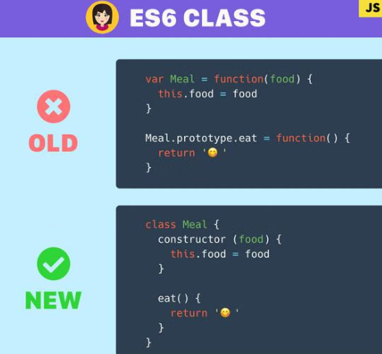
Classes in JavaScript
A class is a blueprint for creating objects.
Introduced in ES6 for cleaner, more structured object-oriented code.
Internally built on prototypes, but easier to read and maintain.
Example:
class Person {
constructor(name, age) { this.name = name; this.age = age; }
greet() { console.log(`Hi, I'm ${this.name}`); }
}
const ali = new Person('Ali', 25);
ali.greet();

Slide 15
The constructor() Method
Instance Methods
Runs automatically when a new object is created.
Used to initialize object properties.
Example:
  class Car {
  constructor(model, year) {
  this.model = model;
  this.year = year;
  }
  }
  const car1 = new Car('Toyota', 2023);
Methods defined inside a class but outside the constructor.
Each object can access them independently.
Example:
  class Calculator {
  add(a, b) { return a + b; }
  subtract(a, b) { return a - b; }
  }
  const calc = new Calculator();
  console.log(calc.add(5,3));

Slide 16
Class Fields
Static Methods and Properties
Introduced in ES2022 for direct property declaration.
No need to use constructor() for initializing fields.
Example:
  class Counter {
  count = 0;
  increment() { this.count++; }
  }
  const c = new Counter();
  c.increment();
  console.log(c.count); // 1
Declared with the 'static' keyword.
Belong to the class itself, not to instances.
Example:
  class MathHelper {
  static square(x) { return x * x; }
  }
  console.log(MathHelper.square(5)); // 25

Slide 17
Inheritance: extends & super
Getters and Setters
Enables one class to inherit properties and methods from another.
'extends' creates the child class, and 'super()' calls the parent constructor.
Example:
  class Animal {
  constructor(name) { this.name = name; }
  speak() { console.log(`${this.name} makes a noise.`); }
  }
  class Dog extends Animal {
  constructor(name, breed) {
  super(name);
  this.breed = breed;
  }
  speak() { console.log(`${this.name} barks!`); }
  }
Control access to object data with computed or validated properties.
Example:
  class Temperature {
  constructor(celsius) { this.celsius = celsius; }
  get fahrenheit() { return this.celsius * 1.8 + 32; }
  set fahrenheit(value) { this.celsius = (value - 32) / 1.8; }
  }
  const temp = new Temperature(0);
  console.log(temp.fahrenheit); // 32

Slide 18
Common Pitfalls and Best Practices with Classes in JS
Always use 'new' when creating class instances.
Arrow functions don’t bind their own 'this' context use normal methods.
Class methods are not hoisted must be defined before used.
Keep static methods for utility purposes only.
Classes in JS are different than classes in CSS.

Slide 19
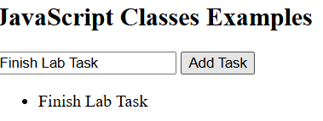
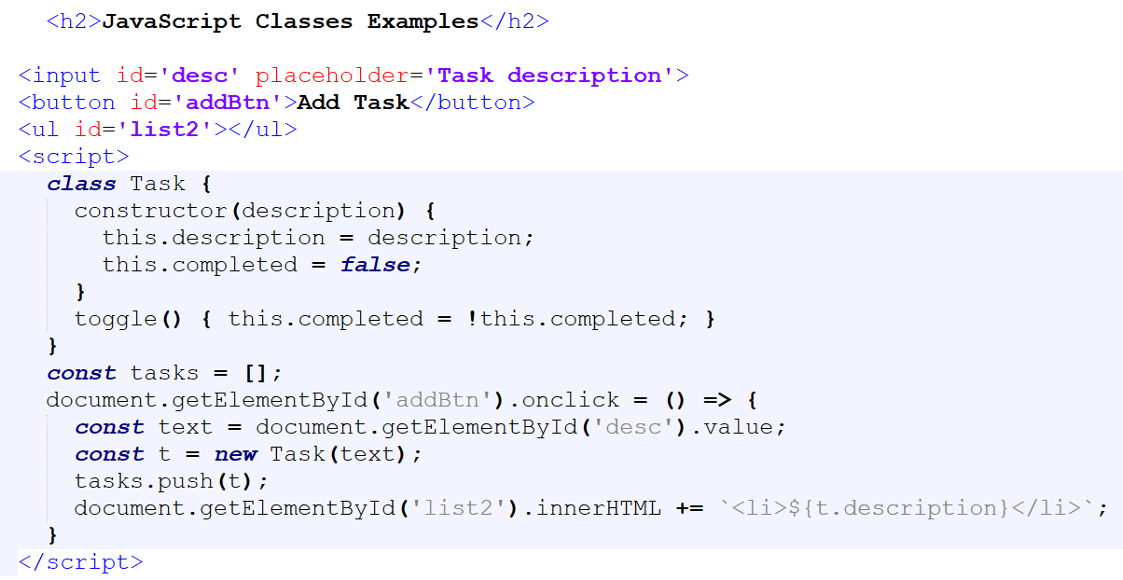
Example Code

Slide 20
Function Default Parameters
function greet(name = "Guest") {
console.log(`Hello, ${name}!`);
}
greet(); // Hello, Guest!
Used to provide function arguments default values to be used if the user did not provide any arguments.
Function Modules Importing and Exporting
Help in splitting JS functions into different files based on modules for easier maintenance.
Use “import” to use functions from other files (functions should have type “export” to be seen out of its own file)
// In file Math.js
export const add = (a, b) => a + b;
//In file main.js
import { add } from './math.js';
console.log(add(2, 3)); // 5
ES6 introduced modules for code organization. Each JavaScript file can be treated as a separate module.
export exposes variables, functions, or classes. Use import that brings them into another file.
You must use <script type="module"> in HTML for this to work in browsers.
    <script type="module" src="main.js"></script>
Browsers treat running JS locally without a webserver as origin null, and block features such as module imports or fetch() requests for security reasons.

Slide 21
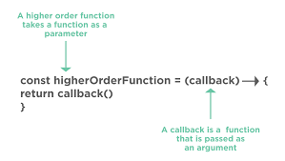
Function Callbacks
A callback is a function passed to another function and invoked later. It allows one function to call another when an operation completes.
Used for events, timers, and older async APIs.
Pitfalls: callback pyramid (callback hell), inversion of control, error handling complexity.
Synchronous callbacks
  The callback executes immediately after being called.
  JavaScript waits for it to finish before moving on.
Asynchronous callbacks
  In asynchronous callbacks, JavaScript doesn't wait for the function to finish and continues executing other code.
  The callback runs later after a delay or external event.
  Common in network requests, file reading, or timers.

Slide 22
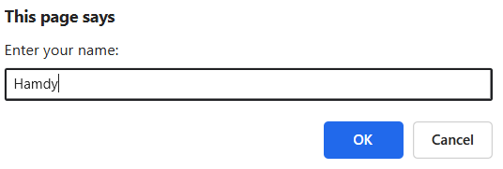

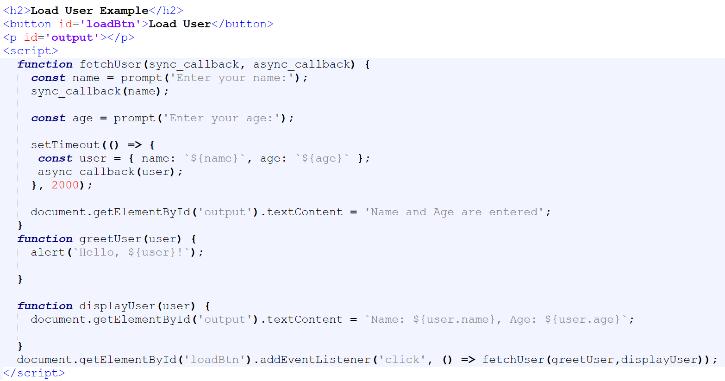
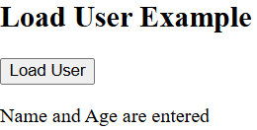
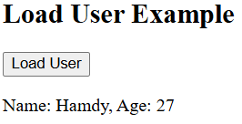
Example Code
Sync callback. The code will run callback and finish it first to continue other codes
Async callback called through setTimeout. Code inside will run after 2 seconds without blocking other codes

Slide 23
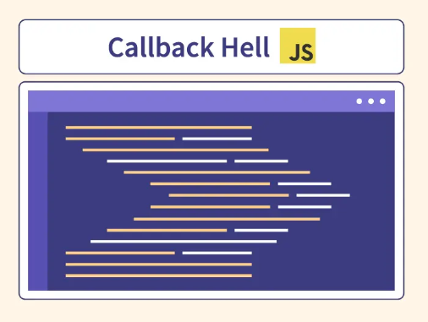
Callback Hell
When multiple asynchronous callbacks are nested, code becomes messy:
  getData(() => {
  processData(() => {
  saveData(() => {
  displayData(() => {
  console.log('Done!');
  });
  });
  });
  });
  // Difficult to debug and maintain.

Slide 24
Lab Task

Slide 25
My Interactive To Do List – No AI Allowed
My Interactive “Pro” To Do List – For Vibe Coders
Build a simple To-Do List web app using HTML, CSS, and JavaScript.
Specifications:
HTML structure (minimum requirements)
  An input field for task description.
  An “Add Task” button.
  A list (<ul> or <div>) to display tasks.
JavaScript (minimum requirements)
  Create a Task class
  Store tasks in an array.
  Add tasks dynamically to the page using innerHTML or DOM manipulation.
  Allow toggling a task’s completion state by clicking on it (change text style or color).
  Allow deleting a task.
  Use simple CSS to mark completed tasks with a strike-through or color change.
Make it look good (experiment with CSS)
Additional requirements:
Persistence:
  Save and load tasks using localStorage.
Filtering & Sorting:
  Add buttons to filter tasks: All, Completed, Incomplete.
  Allow sorting alphabetically or by creation time.
Enhancements:
  Add a timestamp when a task is created.
  Add an “Edit” feature to rename a task.
UI Upgrade:
  Use dynamic icons (✅ ❌ ✏️) instead of text buttons.
  Apply CSS transitions when toggling or deleting tasks.
Task Manager Class:
  Convert the app into a class-based MVC structure (ask the AI tool to tell you what is meant by MVC structure).

